Slide 1

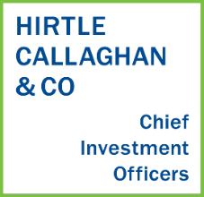
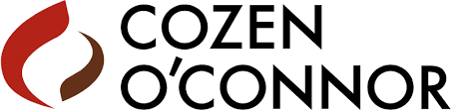
The Ins and Outs of
PRIVATE FOUNDATIONS & DONOR-ADVISED FUNDS
September 20, 2021

Slide 2
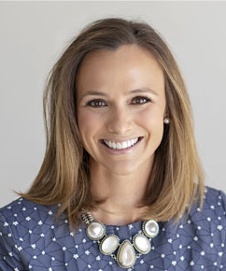
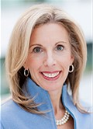
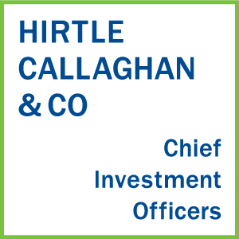
The Ins and Outs of Private Foundations and Donor-Advised Funds
Susan H. McEvoy, CFP | Helene S. Jaron, Esq.
Director, Investment Officer Hirtle Callaghan | Chair, Private Client Trust and Estate Practice, Cozen O’Connor

Slide 3
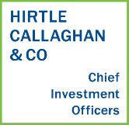
Long-Term Partners to Families
OVERVIEW
OVERVIEW
Leading investment office for families and non-profits
30+ years of experience – Since 1988
Independent, employee-owned firm
Conflict-free and client-aligned
Over 200 client relationships
Manage approximately $17 billion
100+ professionals
97% client retention rate
Full-service firm with 755+ attorneys across 29 cities and two continents
Ranked among the top 100 law firms in the country
Extensive Private Client, Trusts and Estates Group
Represents philanthropic families in the creation of foundations as well as planned giving
Expertise in issues involving public charity board service and advice regarding tax compliance and governance

Slide 4
DAFs Have Grown Significantly as a Percentage of Giving
Source: National Philanthropic Trust 2020 Donor-Advised Fund Report. Individual giving estimates are from Giving USA 2020. All values reflect the most current data available from Giving USA 2020 and from National Philanthropic Trust’s collected data on donor-advised fund (DAF) contributions based on IRS Forms 990 and estimates. We recognize that DAF contributions are not entirely from individuals. Using individual giving consistently as the denominator provides a constant point of comparison.
Notes:
We estimate the odds and magnitude of potential bad outcomes .
Stress test different portfolio during economic crisis.
What happened to you endowment spending?
Stress text your liquidity
By modeling what we are afraid of we can realize the true impact of risk on your organization
Test your behavioral view of risk with your actual portfolio under duress. enables you to pre- experience risk
Not All Risks Are as Bad as They Seem

Slide 5
But the Total Grant Dollars from Foundations Remains Higher
Independent Foundations | 2018 | 2019 | % Change
Charitable Assets | $830.4 | $1,000.7 | 20.4%
Total Grant Dollars | $54.03 | $54.35 | 0.6%
Donor-Advised Funds | 2018 | 2019 | % Change
Charitable Assets | $122.2 | $142.0 | 16.2%
Total Grant Dollars | $23.72 | $27.37 | 15.4%
Source: National Philanthropic Trust 2020 Donor-Advised Fund Report.
Notes:
We estimate the odds and magnitude of potential bad outcomes .
Stress test different portfolio during economic crisis.
What happened to you endowment spending?
Stress text your liquidity
By modeling what we are afraid of we can realize the true impact of risk on your organization
Test your behavioral view of risk with your actual portfolio under duress. enables you to pre- experience risk
Not All Risks Are as Bad as They Seem

Slide 6
What is a Donor-Advised Fund?
A donor-advised fund (DAF) is a separate fund or account that a donor establishes at a public charity (such as a community foundation, university or financial institution).
The assets contributed by the donor to a DAF are owned and managed by the charity, but the donor retains the right to make recommendations with respect to distributions and investments.
The charity is not obligated to accept or implement those recommendations, but as a practical matter, often does.
Notes:
We estimate the odds and magnitude of potential bad outcomes .
Stress test different portfolio during economic crisis.
What happened to you endowment spending?
Stress text your liquidity
By modeling what we are afraid of we can realize the true impact of risk on your organization
Test your behavioral view of risk with your actual portfolio under duress. enables you to pre- experience risk
Not All Risks Are as Bad as They Seem

Slide 7
What is a Private Foundation?
A private foundation is an independent legal entity (either a corporation or trust) which is established by an individual or family for charitable purposes.
The donor appoints a board of directors or trustees to oversee the foundation which is responsible for receiving charitable contributions, managing and investing charitable assets, and making grants to other charitable organizations.
Notes:
We estimate the odds and magnitude of potential bad outcomes .
Stress test different portfolio during economic crisis.
What happened to you endowment spending?
Stress text your liquidity
By modeling what we are afraid of we can realize the true impact of risk on your organization
Test your behavioral view of risk with your actual portfolio under duress. enables you to pre- experience risk
Not All Risks Are as Bad as They Seem

Slide 8
What are the Key Differences?
The most significant difference is control:
    Assets contributed to a DAF are no longer legally under the control of the donor. The donor may advise on the use of funds, but there is no legal obligation for the DAF to abide by that request.
    In a private foundation, board members have complete control over investment and grant decisions.
Private foundations can also give in ways that may not be available through a DAF, such as making grants to individuals, providing scholarships and making program-related investments.
Notes:
We estimate the odds and magnitude of potential bad outcomes .
Stress test different portfolio during economic crisis.
What happened to you endowment spending?
Stress text your liquidity
By modeling what we are afraid of we can realize the true impact of risk on your organization
Test your behavioral view of risk with your actual portfolio under duress. enables you to pre- experience risk
Not All Risks Are as Bad as They Seem

Slide 9
What are the Key Differences Between Charitable Structures?
 | Donor Advised Fund | Private Foundation
Set Up | Establish account with a DAF sponsor | Form new entity Obtain EIN Open new bank account Prepare and file IRS Form 1023
Start Up Costs | None | Legal (and other) fees which can be significant
Ongoing Reporting Obligations | None | File Form 990-PF with IRS annually (a copy also needs to be delivered to the state attorney general) State level annual reports (if formed as a corporation)
Ongoing Management and Fees | 30-90 BPS for administrative fees 15-70 BPS for investment management fees | Varies depending on investment advisor selected by Foundation

Slide 10
What are the Key Differences Between Charitable Structures?
 | Donor Advised Fund | Private Foundation
Tax Deduction Limit for Cash Gifts | 60% of adjusted gross income | 30% of adjusted gross income
Tax Deduction Limit for Stock Gifts | 30% of adjusted gross income | 20% of adjusted gross income
Valuation of Gifts | Fair market value (exception for certain items of tangible personal property if property is not used in exempt programs) | Fair market value for publicly-traded stock, cost basis for all other gifts, including gifts of closely-held stock or real property
Required Grant Distribution | None | Must expend 5% of net asset value annually, regardless of how much the assets earn
Privacy | Anonymous Grants | Public tax returns must be filed
Flexibility in Gifting | Gift must go to a public charity | Gifts can include grants and program-related investments

Slide 11
Questions to Ask Yourself to Choose the Right Structure
CONTROL |  | How important is control over giving vs. maintain anonymity? How much freedom do you want to give current family members? Do you want future generations to follow your mission?
COMPLEXITY |  | How much time can you devote to set up? Are you willing to pay ongoing fees for administration? Do you want to devote time to board meetings?
FLEXIBILITY |  | How do you feel about an annual distribution requirement? Do you want to make grants or program-related investments? Do you want to be able to create jobs for family members?

